Slide 1
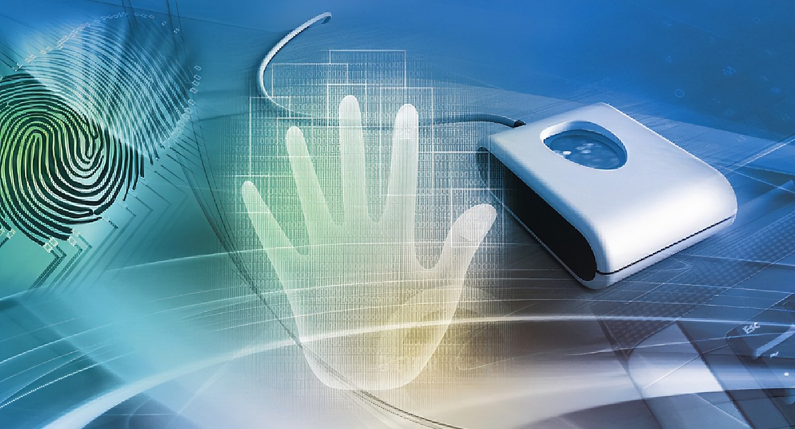
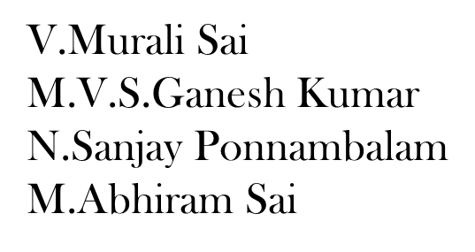
GESTURE GENIUS TEAM ALPHA

Slide 2
The Project
In today’s scenario people are using high end expensive consoles to play motion sensing games.
PC gaming has numerous advantages over console gaming.
PCs can be upgraded to high graphics and high processing power where as consoles cannot.
Number of PC gamers in the world is also much higher than the Console gamers.
But these PC games are played with controller like keyboard, mouse and joysticks.
So in this project we completely focused on delivering motion gaming experience on PC gaming.

Slide 3
The History
We feel game development is an area we will enjoy to work in, but also even in the current economic downturn there is a rapidly growing market in the gaming area.
Another reason for choosing the specific area of this game was to push ourselves and learn about a new upcoming technology.
Other Technologies like the Wii or Play station both use motion technologies. But these technologies did not have as much functionality that could be used whereas with the gestures of hand you track many different elements with no need for a hand held controller.

Slide 4
Benefits
It improve gaming experience of PC gaming by enabling people to operate PC games through gestures.
It provide user friendly and easy to use gesture set for playing PC games.
It attract gamers toward PC gaming as there are lots of advantages of PC gaming
over Console gaming.
promotes controller free gaming as this user will not need have games controller like keyboard, mouse or joysticks.
It offer experience of motion gaming for PC games without need of expensive gaming console and additional game controllers.
It deliver motion sensing gaming experience at very cheap cost as people will not need to buy consoles if they want to play normal PC games .

Slide 5
Limitations
People cannot spend much time playing the game as they will become tired after some time
Addiction to game is one of the limitation
Invisible boundary of activity area is potential problem as camera cannot recognizes wide range of action.
As it is a gestured mode even the small movement in hand will be recognized ,so it will be
Difficult to control than mouse or any other controlled devices.

Slide 6

Approach
SOFTWARE REQUIREMENTS:
Mediapipe for hand detection module
Opencv –python for image processing module
PYDIRECT INPUT FOR KEYBOARD INPUTS
AUTOPY FOR MOUSE MOVEMENTS
TKINTER MODULE FOR GUI
HARDWARE REQUIREMENTS:
Web camera should be present in pc or laptop
Minimum Processor of i3 is required

Slide 7
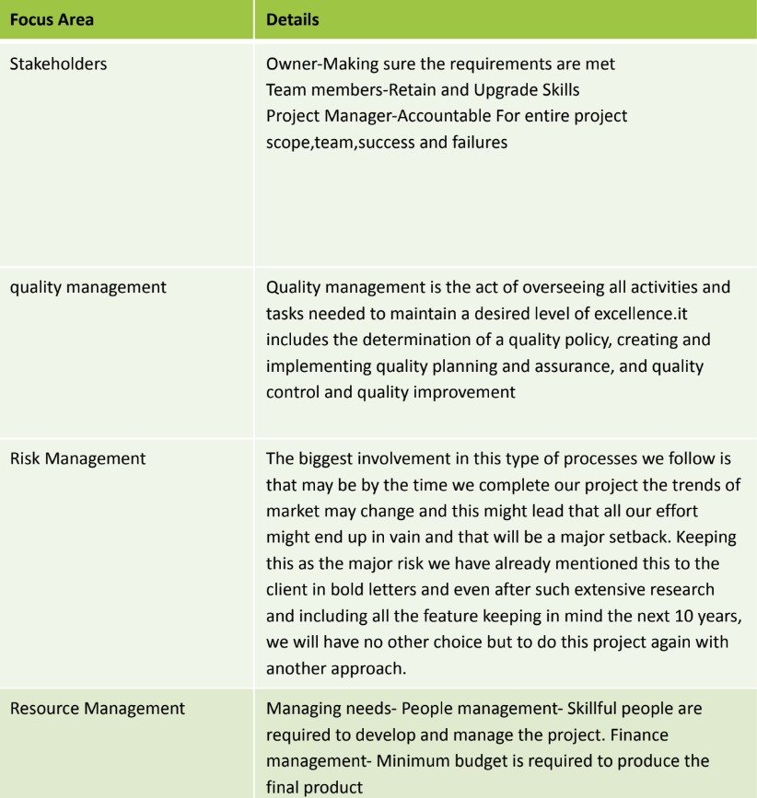
Project Management Plan

Slide 8
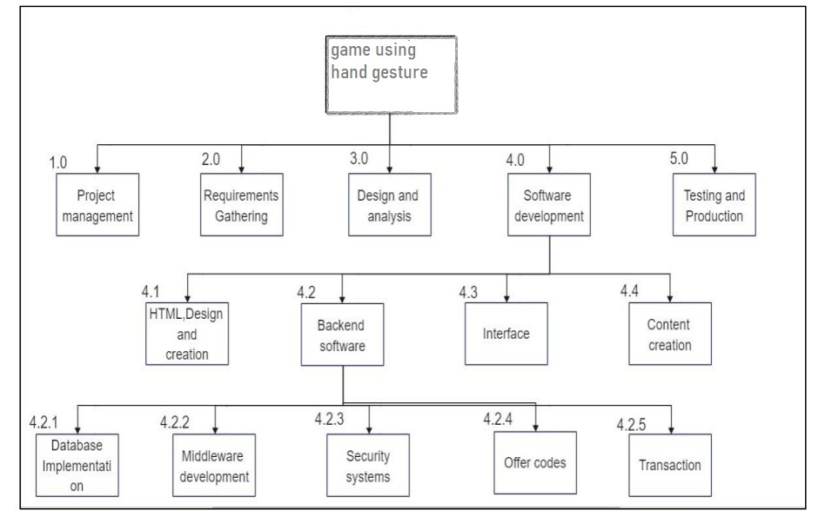
Work Break Down Structure

Slide 9
Risk analysis
- SWOT & RMMM
Strengths
Weakness
⦁ Reliable vendors
⦁ Prompt services
⦁ Save Time & Money.
⦁ Price Range.
⦁ High-Tech requirements
⦁ Cannot show Emotions.
⦁ Limited Availability of data.
Oppurtunities
Threats
⦁ New rules on the environment
⦁ changes in demographics
⦁ Improve Lead Generation.
⦁ scaling up success
⦁ Government Regulations
⦁ Expensive
⦁ Lack of long-term supplier contracts

Slide 10
RESPONSE | STRATEGY | EXAMPLES
Avoid | Risk avoidance is a strategy where the project team takes action to remove the risk or protect from the impact | ⦁Extending the schedule ⦁Reducing/removing scope ⦁ Change the execution strategy
Transfer | Risk transference involves shifting or transferring the risk threat and impact the third party, Rather transfers the responsibility and ownership | ⦁ Purchasing insurance ⦁ performance bonds ⦁ Warranties ⦁ Contact issuance
Mitigate | Risk migration is a strategy where the project team takes action to reduce the probability of the risk occurring. This does not risk or potential impact, but rather reduces the likelihood of it becoming real. | ⦁ Increasing testing ⦁ Changning suppliers to stable one ⦁Reducing process complexity

Slide 11
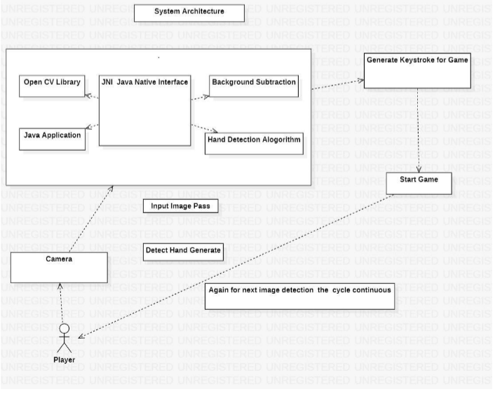
SYSTEM ARCHITECTURE

Slide 12
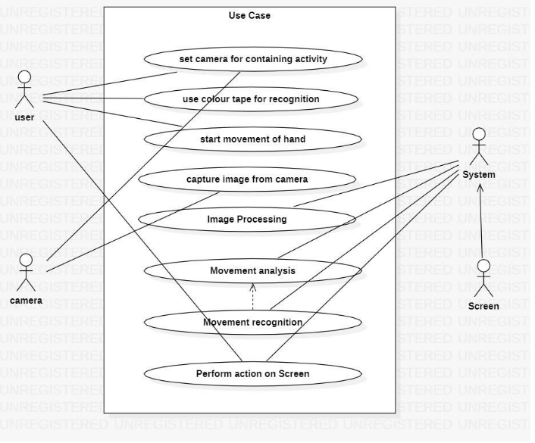
USE CASE DIAGRAM

Slide 13
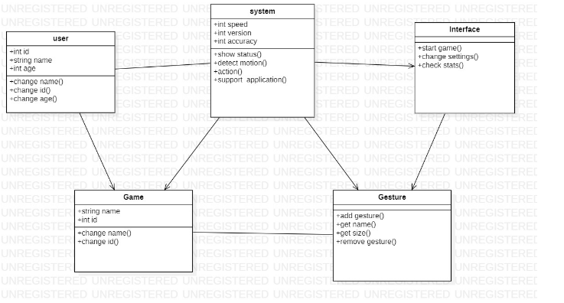
CLASS DIAGRAM

Slide 14
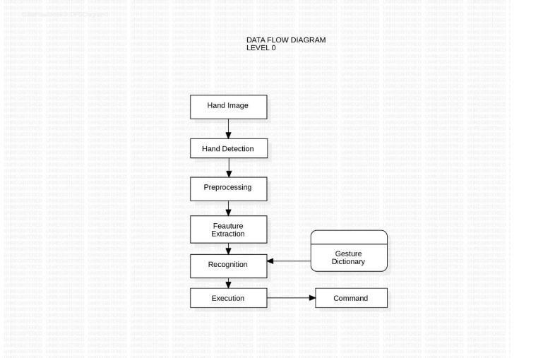
Data Flow Diagram (At Level Zero)

Slide 15
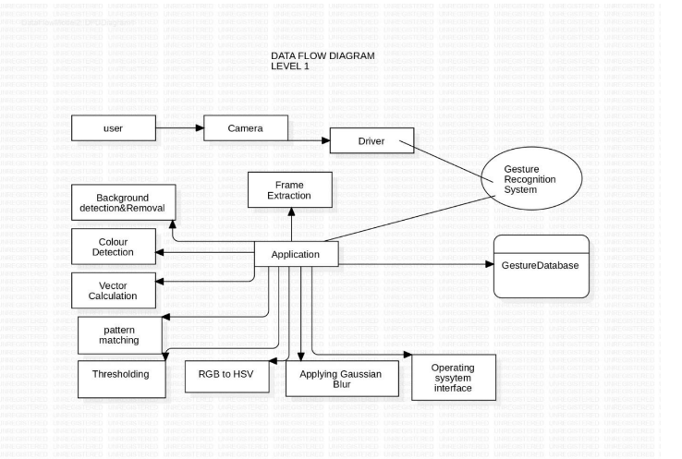
Data Flow Diagram (At Level ONE)

Slide 16
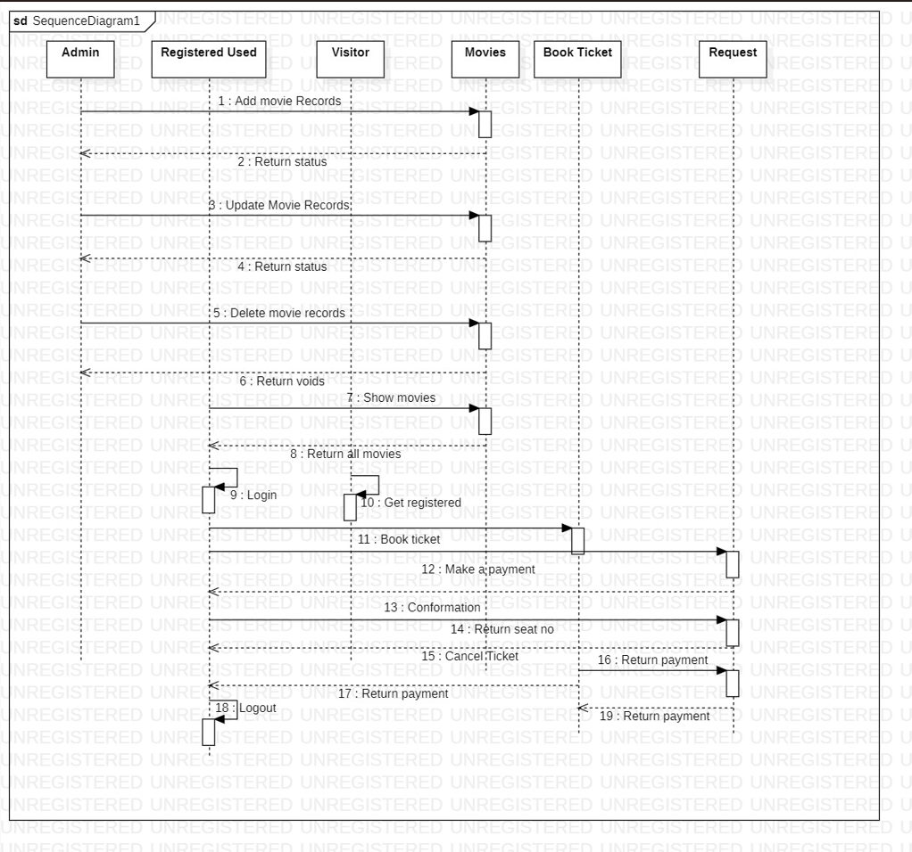
Sequence Diagram

Slide 17
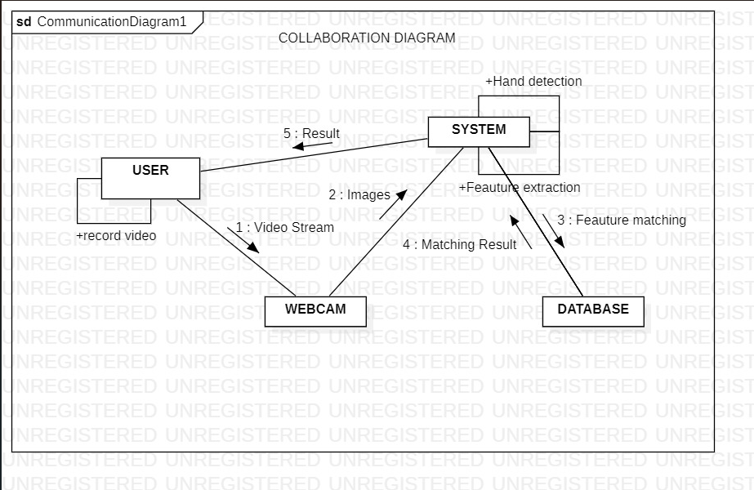
Collaboration Diagram

Slide 18
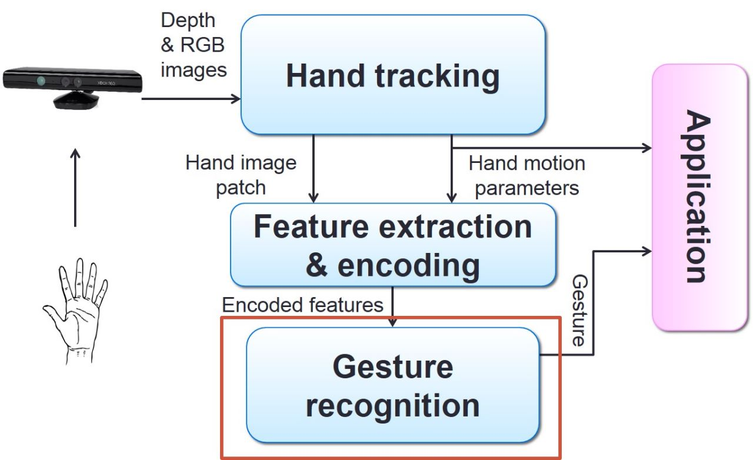
GENERAL VISUALIZATION

Slide 19
EXPLANATION
Tkinter is a Python library used to create graphical user interfaces (GUIs). In the above code,
a Tkinter GUI is created with the title "GESTURE GENIUS" and dimensions 900x500.
The GUI has a black background and includes an icon image and a product image. Two buttons are also created: "START"
and "EXIT".
The "START" button is associated with the start() function, which captures video frames from the webcam, processes the
frames to detect hand landmarks and finger positions using the Mediapipe library, and performs actions based on the
finger positions.
For example, if the pointing finger is up and the thumb is down, the mouse cursor is moved to a location on the screen.
If the pointer finger is down and the thumb is up, a left mouse click is performed.
If all fingers are up, the right arrow key is pressed, and if all fingers are down, the left arrow key is pressed.
The "EXIT" button is associated with the end() function, which closes the GUI. Overall, this code uses
Tkinter to create a GUI that allows the user to interact with the computer using hand gestures captured by the webcam.

Slide 20
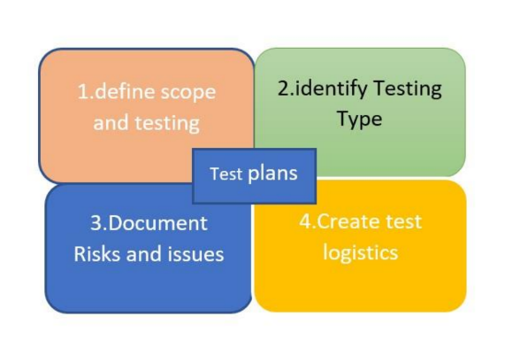
Test Plan
1)Define scope and testing
2) Identify testing type
3) Document risks and issues
4) Create test logistics

Slide 21
Thank you
-Team Alpha
TEAM MEMBERS
V.Murali Sai
M.V.S.Ganesh Kumar
N.Sanjay Ponnambalam
M.Abhiram Sai

